Slide 1
Unbaking Cakes
A multi-lingual adventure
Mark “The Fat Panther” Takata

Slide 2
Who is this guy?
Full stack web developer & Business Analyst
Started programming in ColdFusion in 1998
Founder & Developer, Takata Technology Consulting, Pretty Good AI, AIMLAR.com, on contract with UC Davis Financial Aid (2 weeks left).
Background in C#, CF, JS, PHP, SQL and other letters of the alphabet
West Sacramento, CA (which is west of Sacramento)

Slide 3
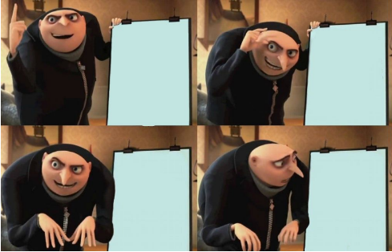
20 years as a dev
Only 2 whiteboard interviews
100% horrendous failure rate
100% horrendous failure rate

Slide 4
OK why we here dude?
Solving a trivial array/string transform challenge
Going to use a number of different languages
Idea is to show differences/similarities

Slide 5
What’s your problem(s)?
We will be building two functions:
1st will take in an array of strings & output a string which is all of the array elements concatenated together.
2nd will take in that concatenated string and output the original array.

Slide 6


Slide 7
Challenges & Signatures
Information is lost when crossing functions
Need to pass some form of meta-data
You could put in demarcation but…
You’d need to escape it
This gets complicated
Or you can build a header that contains data about the original array items

Slide 8
Tools required to solve this
Ability to manipulate, create, edit arrays
Some way to put strings together
Looping
Ability to find a character
Some way to count characters
A form of “sub-string” where you can select part of a string

Slide 9
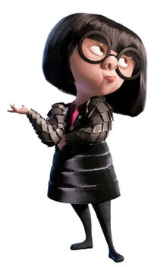
How this gonna work
Built a little UI to put together an array
This is held in a global variable available to the page
Also placed into a form element & passed to pages (passed as a list)
To do this, I had to cheat a bit (no commas!)

Slide 10
Let’s get in the code already!

Slide 11
Thanks everyone!
Twitter: @TheFatPanther Email: Techfiend@gmail.com Github: https://github.com/MarkRTakata/UnbakingCakes

